Slide 1
Component-Level Software Design
Phil Pfeiffer
February 2013
Key Source: Barrett course notes, CSCI 5300, spring 2010

Slide 2
Fundamentals
Executable units of independent production, acquisition, and deployment that can be composed into a functioning system.
-- C. Szyperski, Component Software
One step above classes
▪ Components typically reentrant - preserve no state
▪ Can't use to instantiate multiple components
Defined by interfaces (API)
▪ Interface = function signatures + behavior specification
▪ Functionality accessed only through interface

Slide 3
Motivation: Value
The cost of COTS software is 1/100th that of traditional single-use code.
Attributed to Stanford's Ed Feigenbaum,
formerly USAF chief scientist (1995) Differential "may be even more extreme today."
Will Tracz, "COTS Myths and Other Lessons Learned in Component-Based Software Development", in Heineman, G. and Counsell, W., Component-Based Software Engineering

Slide 4
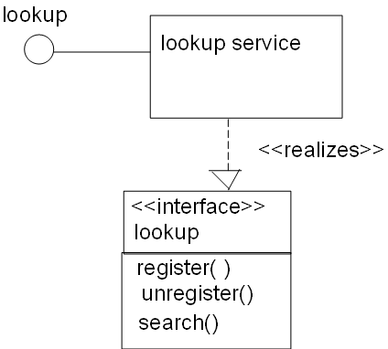
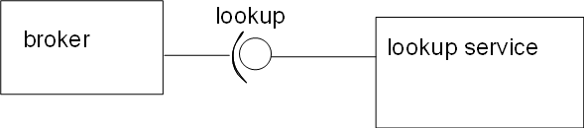
Components vs. Classes: Broker depicted here: class diagram, component diagram

Slide 5
Broker Example
Class diagram shows internal structure
Component diagram hides it
▪ Implementation, however, irrelevant --
▪ Designers use component as-is

Slide 6
Common Implementations
▪ As source codes
▪ examples: procedures, classes
▪ use: compiled, then linked to executable
▪ advantages
▪ allows for white-box testing before release
▪ executables are self contained - no "DLL hell"
▪ As binaries
▪ examples: .dll's/.so's ; GUI widgets; DB front ends (e.g., ODBC); COM, CORBA, EJB objects
▪ use: distributed as binary, linked into executable
▪ advantages
▪ smaller applications through shared code (.dll's, .so's)
▪ source remains confidential
▪ simplifies upgrades by allowing for component swap

Slide 7
Finding Components
▪ Marketplace drives availability
▪ High reuse ➔ high availability
▪ Low reuse ➔ low availability
▪ Potential for reuse depends on generality
▪ foundation components - most common
▪ architectural components - high
▪ business components - lower
▪ application components - lowest
Meilir Page-Jones, Fundamentals of Object-Oriented Design. Original text references "reuse classes". Ideas framed here in terms of components.

Slide 8
Foundation Components
model concepts common to human enterprises: e.g.,
▪ math: e.g., integers, reals.
▪ natural world: e.g., time, distance, color.
▪ human language: e.g., characters, words.
▪ units of value: e.g., dollars.
▪ object collections: e.g., sets, queues, trees, maps.
with rare exceptions, purchase from vendors
Architectural Components
model elements of computing platforms.
▪ hardware objects: e.g., printers, disks
▪ software subsystems: e.g., databases, sockets
▪ interface elements: e.g., windows, menus
easy to obtain, but may be harder to use, due to vendor lock-in, cross-component incompatibilities

Slide 9
Business Components
model aspects of specific enterprises
▪ object attributes: e.g., human vital signs, grades, bank balances.
▪ roles: e.g., doctors, teachers, customers
▪ relationships: e.g., patientOf, studentOf, customerOf.
aren't available yet for many businesses
consortia like the Object Modeling Group (CORBA) working to change this
Application-Specific Components
model work done by specific applications.
have inherently low reuse

Slide 10
Using COTS Components: 15 Myths
Myth #1: It's important to know what commercial off-the-shelf (COTS) components can do for you.
Reality: It's important to know what COTS components can do to you.
Matching NFR's with nonfunctional component properties
Resolving problems when different vendors' components don't integrate
Will Tracz, "COTS Myths and Other Lessons Learned in Component-Based Software Development", in Heineman, G. and Counsell, W., Component-Based Software Engineering

Slide 11
Using COTS Components: 15 Myths
Myth #2: COTS-based systems are built top-down.
Reality: COTS-based systems are built bottom-up.
Components facilitate spiral development
Myth #3: An "Open Systems" architecture solves the COTS component interoperability problem.
Reality: There is no standard definition for "open system", and "plug and play" doesn't always work.
The number of plug-compatible components for open system
standards has yet to reach critical mass

Slide 12
Using COTS Components: 15 Myths
Myth #4: You don't need to test COTS components.
Reality: You need to test COTS components more thoroughly because you don't know how they were built.
What's advertised, delivered often differ.
Myth #5: COTS product selections are based on extensive evaluation and analysis.
Reality: COTS product selections are often based on slick demos, Web searches, or trade journals.
Hard to stay current with evolving technology.

Slide 13
Using COTS Components: 15 Myths
Myth #6: COTS components come with adequate documentation.
Reality: Features sell COTS components, not documentation.
The integrator is expected to make do with what's provided.
Myth #7: You can configure a COTS-based system to meet your requirements.
Reality: You can configure your process to meet the COTS component's capabilities.
COTS can typically meet 80% of customer requirements
for 20% cost of a custom system in 20% of the time
▪ The final 20% costs more than traditional development
▪ Modifying COTS more difficult, due to lack of control and insight into product design, documentation, construction, testing
▪ Customizations also incur maintenance costs on COTS upgrades

Slide 14
Using COTS Components: 15 Myths
Myth #8: The processes COTS producers use reflect our industry's best practices
Reality: The processes COTS producers use often only reflect the producer's market schedule and domain experience.
Most COTS producers have rollout plans that include extended features and hooks to allow tailoring.
Myth #9: You buy a COTS component.
Reality: You buy the right to use a version of a COTS component.
The maximum shelf life of a COTS component is two years.

Slide 15
Using COTS Components: 15 Myths
Myth #10: Vendors will fix problems in the current release of a software component.
Reality: Vendors may fix problems in a component's next release.
Level of service, without service contract, is market-driven.
Duration between versions and patches can be long.
Myth #11: If you are a large enough customer you can influence COTS component suppliers.
Reality: The market influences COTS component suppliers.

Slide 16
Using COTS Components: 15 Myths
Myth #12: COTS-based systems are a panacea
Reality: COTS components exacerbate inadequacies in a development process by compressing the development schedule.
COTS can be faster, cheaper, and better for
▪ relatively simple applications
▪ immature problem domains
▪ problems that require a small number of mature components
▪ problems with proven integration mechanisms
Not all applications fit this description
Myth #13: COTS components are free except for purchase cost.
Reality: System sustainability issues overwhelm acquisition costs.
The largest problem with COTS is its short life span.
The half-life of COTS product expertise is six months (Kurt Wallnau, Software Engineering Institute).

Slide 17
Using COTS Components: 15 Myths
Myth #14: You can ignore producer upgrades
Reality:
You lose support of back systems if you ignore vendor upgrades.
Producer upgrades are often required to repair previously defective versions.
Myth #15: You can pay a vendor to modify COTS components to meet your requirements.
Reality: You can pay a subcontractor to modify COTS components to meet your requirements

Slide 18
COTS: 12 Rules of Thumb (Tracz)
Cost = 1/100th traditional single use code.
Maximum shelf life of a COTS component = two years.
Half-life of COTS product expertise = six months.
The largest problem with COTS is its short life span.
You need to evaluate COTS in an environment as close to the operational environment as possible.
You can never make a 100% Diminishing-Manufacturer-Source-resistant COTS-based solution.
The smaller the customer base, the higher the cost & better the service.
Avoid cutting-edge products unless required for adequate performance.
Using COTS decreases development time, increases integration time.
Using COTS components either creates or mitigates risk.
A COTS-based system may not be the cheapest solution.
A COTS-based system will never completely meet a customer's needs.

Slide 19
Do-It-Yourself: Building Components
Syzperksi, Component Software:
▪ Most components must be used 3 times before breaking even: i.e.,
▪ Two-separate, from-scratch efforts cheaper than single effort to produce a reusable component
One motivation: software product lines
▪ Managing development of related applications as a single project: e.g.,
▪ variants of common product (HP printers)
▪ product targeted for different platforms

Slide 20
Do-It-Yourself: Composing Components
▪ Common Use Principle
▪ A component's classes should be used together.
▪ If you use one class in a component, you should use them all.
▪ Common Closure Principle
▪ A component's classes should be closed together against the same kinds of changes.
▪ A change that affects a component should affect
▪ all of that component's classes and
▪ no other components.

Slide 21
Do-It-Yourself: Evolving Components
▪ Releasing interface freezes signatures, semantics
▪ Codes that depend on production interfaces require stable signatures, behaviors
▪ Rules for changing functions in production interfaces
▪ Change of implementation OK
▪ Change of specified behavior not OK
▪ Change of signature, as a rule, not OK
▪ Exception: adding new keyword parameters for
languages that support these
▪ Changing behaviors requires extensions
▪ Adding new functions to existing component interfaces
▪ Adding new interfaces to component

Slide 22
COTS Frameworks
Platforms ("software backplanes") for interoperable objects
Three sketched here
▪ Java component models (Beans, EJB, J2EE)
▪ Common Object Request Broker Architecture (CORBA)
▪ Component Object Model (COM)+ /
Common Language Runtime (CLR)
Sources:
Szyperski, Clemens, Component Software: Beyond Object-Oriented Programming, 2nd Edition
Heineman, George and Counsell, William, Component-Based Software Engineering
OMG home page, www.omg.org
Phaoroah, A., Siegel, J., and Brooke, C., Creating Commercial Components,
http://www.componentsource.com/services/whitepapers/corbawhitepaper.asp
Stearns, B., JavaBeans 101, http://java.sun.com/developer/onlineTraining/Beans/bean01/

Slide 23
Java Component Technologies
Software backplane = Java Virtual Machine
Five kinds of components (and counting?)
▪ applets
▪ downloadable small applications that run in context of larger application - originally, in web apps
▪ checked for safety in runtime context when loaded
▪ restricted functionality
▪ JavaBeans
▪ Enterprise JavaBeans (EJB)
▪ Servlets
▪ J2EE Application Components

Slide 24
JavaBeans
Consist of 1 or more Java classes
Follow "bean" design conventions
▪ Properties - control a bean's appearance and behavior
▪ Events - for communication with other beans; signal and receive
▪ Persistence - for saving (serializing) and restoring state
▪ Methods - standard Java methods; exported by default
▪ Introspection - components can be queried for properties
Assembled by toolkits called (application) builders
Dual usage model
▪ At design time - operate in application builder context
▪ At runtime - operate in runtime context
▪ Can query context, to determine (e.g.) if GUI is available
▪ Support connection-oriented computing

Slide 25
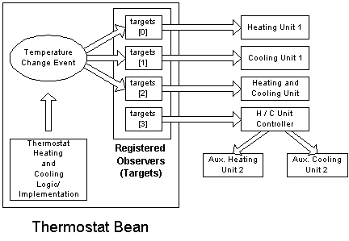
JavaBeans Example (Sun Tutorial)
Bean registers with thermostat sensor component to receive temperature changes
Heating and cooling components register with thermostat bean to receive directions

Slide 26
JavaBeans packaging - JAR files
▪ contents
▪ manifest
▪ set of class files
▪ set of serialized objects for bean prototype instances
▪ optional HTML help files
▪ optional local information for bean self-localization
▪ optional .gif icons
▪ other resources needed by the bean
▪ can contain multiple beans
▪ methods can be invoked through command line,
by class name

Slide 27
Enterprise Java Beans (EJB)
Largely unrelated to JavaBeans
▪ except in name, in use in Java, in JAR-based packaging
Support declarative characterizations of deployment, operating requirements
▪ beans in the current component and their relationships
▪ methods
▪ security and transaction requirements
▪ this is apparently the key payoff
Provide two interfaces
▪ home interface - for lifecycle operations
▪ creating new beans, finding beans, removing beans
▪ remote interface - implements business methods
Run inside EJB server - typically at a database
▪ implements declarations
▪ restricts bean access to the two interfaces

Slide 28
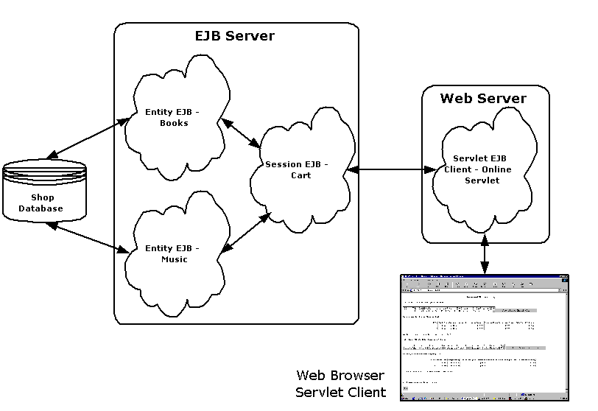
EJB Example

Slide 29
Types of EJB's
Session beans
▪ Created by clients as contact points for communications
▪ Two types: stateless and stateful
▪ Example of stateful: shopping cart
▪ Example of stateless: apply discount
Entity beans
▪ Operate as business objects
▪ Represent data in persistent stores (e.g., databases)
▪ Support concurrent access by clients
▪ Two kinds, based on store synchronization protocols
▪ Bean-managed persistence
▪ Container-managed persistence

Slide 30
Java Servlets
Live on server
Usually lightweight applications
▪ typically instantiated by web server processing web pages,
based on declarative definitions with technology like JSP
Packaged in web archive (.war) files
Java Application Client Components
Unconstrained Java applications running on clients
Characteristics
▪ use Java Naming and Discovery Interface (JNDI) to access environment properties, EJBs, and J2EE server resources
▪ packaged in enterprise archive (.ear) format

Slide 31
CORBA
Custodian: Object Management Group (1989)
▪ largest computer industry consortium (800+ members)
▪ international, open membership, not-for-profit
▪ www.omg.org
OMG standardization activities
▪ real-time, embedded and specialized systems
▪ system analysis & design (e.g., MDA, UML)
▪ architecture-driven modernization and middleware
▪ industry-specific information management standards
▪ business modeling and integration, C4I, finance,
government, healthcare, legal compliance,
life sciences research, manufacturing technology,
robotics, software-based communications, space.

Slide 32
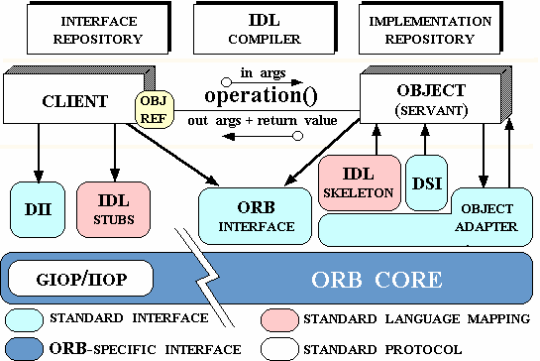
CORBA: Process Model

Slide 33
CORBA
▪ Client obtains compile-time access parameters for service
▪ Interface signature, reference to service
▪ Interface description language (IDL) bindings available for
C, C++, Java, PL/1, COBOL, Java, Python
▪ Client obtains access to service via obj request broker (ORB)
▪ Client passes request at run-time to ORB
▪ ORB activates "servant" object, if required
▪ Object adapter manages client ↔ servant message flow
▪ IDL provided for compile-time-known method calls
▪ Dynamic interfaces support run-time method change
▪ Dynamic invocation interface (DII) - client-side access
▪ Dynamic skeleton interface (DSI) - servant-side interface provisioning
GIOP/ IIOP - analogous to OSI model presentation, session layers

Slide 34
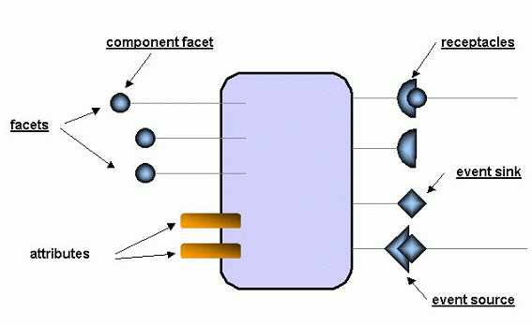
CORBA Component Model (CCM)
Standard for CORBA
components
Model elements
▪ facets - interfaces for clients
▪ attributes - support component configuration
▪ receptacles - for interacting with components via synchronous message passing - i.e, interfaces to supporting components
▪ event sources/sinks - for interacting with other components via asynchronous events

Slide 35
Microsoft .NET
Language runtime + component library +
support for component creation
Amalgam of a succession of component technologies
▪ Component Object Model (COM+) -- i.e.,
▪ Component Object Model (COM), with
▪ Microsoft Transaction Server (MTS), with
▪ Microsoft Message Queue Server (MSMQ)
▪ Common Language Runtime (CLR)
▪ Windows platform access services

Slide 36
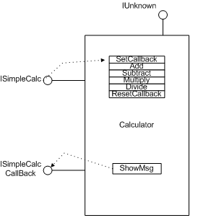
COM Component
▪ Binary implementation
▪ List of pointers to binary functions (vtable)
▪ Semantics
▪ Components implement interfaces
▪ 128-bit global identifier (GUID)
▪ Set of at least 3 methods
▪ QueryInterface - interface lookup
▪ returns true iff current component supports caller-named interface
▪ AddRef, Release - for reference- counting component
▪ initialized to 1 on creation
▪ component should self-destruct
when ref count falls to 0
▪ Every component
▪ must implement IUnknown interface
▪ acts as component's identifier
▪ may implement other interfaces

Slide 37
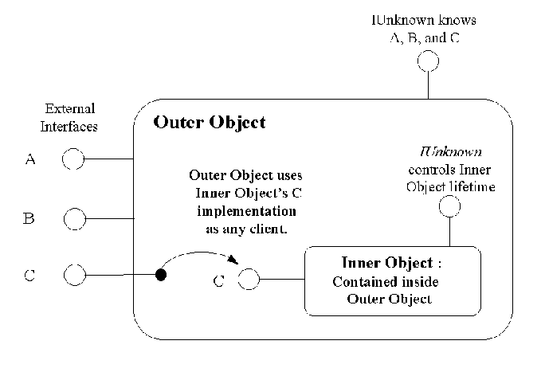
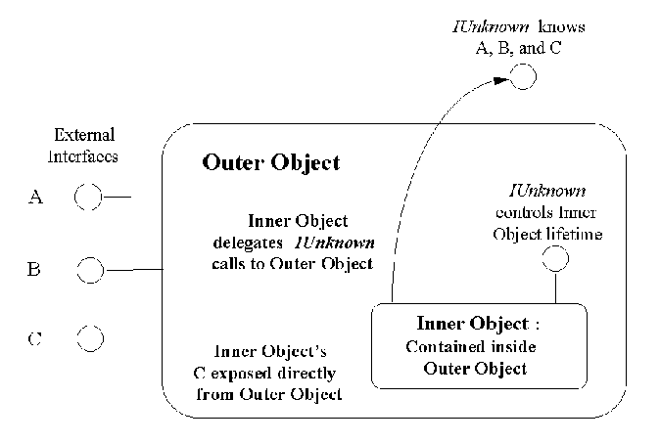
Composing COM Components
Containment - outer component delegates work to inner component
Aggregation - outer component exposes inner components' methods
Grouping COM Components
Category - set of components that, collectively
▪ support a specified set of interfaces
▪ implement a specified subset of these interfaces' methods
▪ Definitions left largely to Microsoft

Slide 38
Activating COM Components
Caller requests activation using COM library's CoCreateInstance
▪ activation requested by class ID (CLSID)
▪ CoCreateInstance locates COM server, using Service Control Manager (SCM)
▪ server could be in-process, locally hosted, or remotely hosted
▪ Servers manage objects that they know
▪ includes problems of translating requests across processes, hosts
Running COM Components
Apartments -runtime-managed thread synchronization
Microsoft Transaction Server - online transaction processing, incl.
▪ management of pools of request handler threads
▪ mapping of components to server processes

Slide 39
COM+
Released in mid-2000
Adds support for declaring infrastructure requirements
▪ application-level (selected)
▪ transaction
▪ activation type: library (in process) or server (separate process)
▪ authentication: none, connect, call, packet, integrity, privacy
▪ authorization checks: application-only or app-and-component
▪ enable compensating resource manager
▪ process shutdown: never or N minutes after idle
▪ security identity: interactive user or hard-coded user/password
▪ component-level (selected)
▪ load balancing: on/off
▪ auto-deactivation: on/off
▪ instrumentation events: on/off
▪ object pooling: on (and min/max insstances, timeout)/ off

Slide 40
.NET Framework
Common Language Runtime (CLR)
▪ implementation of MS/HP/Intel common language infrastructure (CLI) specfication
▪ includes definitions of an intermediate language and deployment file formats (assemblies)
▪ features beyond CLI
▪ support for COM
▪ direct access to Win32, other platform APIs
Atop CLR: .Net frameworks
▪ security, configuration, globalization, application management, I/O, messaging, remote application management, serialization, debugging, compilation, code generation, Internet and web access, XML

Slide 41
Java vs. Corba vs. COM vs. CLR
Binary interfacing
▪ finessed with Java, CLR using bytecode, CIL respectively
▪ lacking in CORBA
▪ at heart of COM
Source-level standards for compatibility and portability
▪ one of CORBA's strengths, with language bindings
▪ Java ports; interoperability with other languages varies
▪ COM lacks source-level standards, standard language bindings
▪ CLR supports high degree of language interoperability
Memory management
▪ lacking in CORBA
▪ Java, CLR support garbage collection
▪ COM and DCOM rely on reference counting, which is only as robust as the components' implementations thereof

Slide 42
Java vs. Corba vs. COM vs. CLR
Container-managed persistence
▪ key strength of EJB
▪ lacking in COM+, CLR (as of 2002)
Development environments
▪ Mature for COM, Java, .NET
▪ lacking for CORBA
Web service components
▪ no specialized models for COM, CORBA
▪ Java has JSP
▪ .Net has ASP.Net
Wire protocols
▪ CORBA supports IIOP/GIOP; OMG supports XML at app-level
▪ Java supports IIOP, Java Remote Method Invocation (RMI)
▪ COM uses DCOM
▪ .Net supports COM, DCOM protocols, plus XML/SOAP

